Slide 1
SIKHISM
By Phoebe Payne

Slide 2
CONTENTS
What is Sikhism?
What do Sikhs believe in?
Festivals and celebration
The symbol and worshiping
Marriage

Slide 3
What is Sikhism?
Back to contents
Sikhism was founded 500 years ago and is the fifth largest religion in the world. It is one of the worlds youngest religions but it has not derived from any other religion. It approximately has 20 million followers, which are mostly in the Punjab state in India. The founder is Guru Nakak and the sacred text is called the Guru Granth Sahib.

Slide 4
WHAT DO SIKHS BELIEVE IN?
Back to contents
Sikhs are the people who follow Sikhism. They like to believe that all humans should be equal and have peace between each other. They only had one god and to them it does not matter about your skin colour or your gender. Every Sikh has the same rights and responsibilities. They live in honesty and meditate to remember and focus on Waheguru (otherwise known as the moon mantra) their god.
They do not believe in fasting, superstitions, ritualism, caste system, alcohol, smoking or drugs.

Slide 5
Festivals and celebration
Back to contents
Hola Mohalla is a festival held in February-March and is a time when Sikhs show their skills at horsemanship, martial arts, and athletics.
Diwali is held in October and is a festival about the story of Hargobind, the sixth guru is told.
Baisakhi is a festival in March-April and it is new years day in the state of Punjab.
Guru Nanak’s birthday is in October-November and 5 people carry the sacred book through the streets in memory of him.

Slide 6
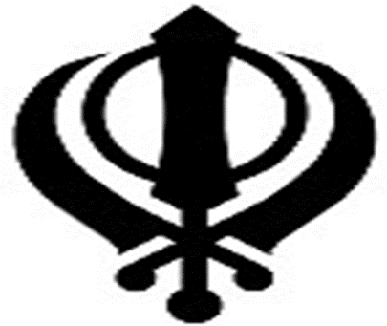
The symbol and worshipping
Back to contents
The symbol for Sikhism is called the Khanda and is made up of:
The Khanda: a double edged sword which represents the belief 1 god.
The Chakkar: a circle representing God without beginning or ending
and reminding Sikhs to remain within the rule of God and no one else.
Two crossed Kirpans: (swords) representing spiritual authority and
political power.
Sikhs worship at home called the Gurdwara (gateway to the guru).

Slide 7
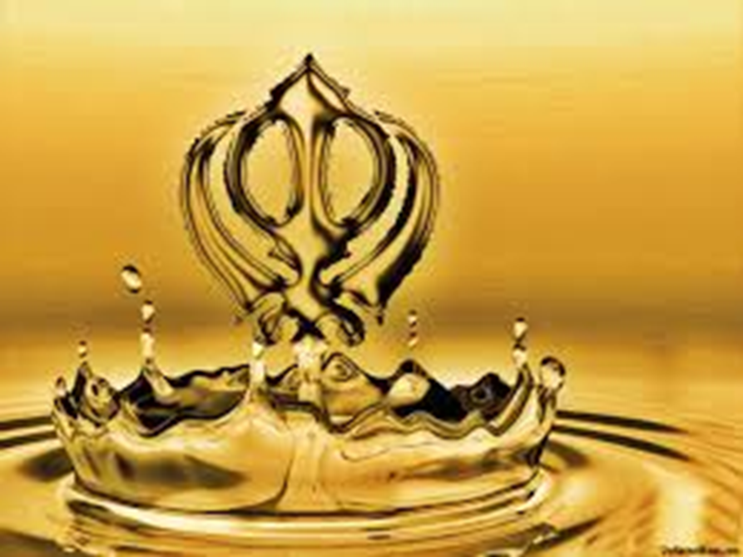
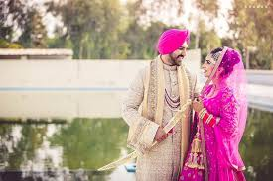
Marriage
The Sikhs marriage ceremony is called Anand Karaj. At the wedding, they read out the sacred book and after each section of it, the bride and groom walk around the Guru Granth Sahib (the sacred book). This procedure is done 4 times. After that, a prayer is read for the newly married couple and hymns are sung.

