Slide 1
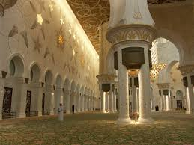
ISLAM
By Oscar

Slide 2
CONTENTS
HOW AND WHERE IT BEGAN.
POPULARITY AND RELIGION
FESTIVALS
THE FIVE PILLARS

Slide 3
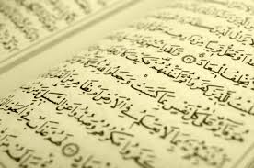
HOW AND WHERE IT BEGAN
HOW AND WHERE IT BEGAN
Islam started in the country of Arabia and began with a person named Prophet Muhammad. Islam people and people that believe in Islam are called Muslims. Muslims believe that there is only one god, who knows all. His name is Allah. The place it started was in a place called Saudi Arabia. The sacred text is known as the Qur’an.
Islam started in the country of Arabia and began with a person named Prophet Muhammad. Islam people and people that believe in Islam are called Muslims. Muslims believe that there is only one god, who knows all. His name is Allah. The place it started was in a place called Saudi Arabia. The sacred text is known as the Qur’an.

Slide 4
POPULARITY AND RELIGION
Islam is the second most popular religion in the world. It has over 1,000,000,000 (a thousand million) followers. But the Muslims themselves think of the their life style as a way of life rather than a religion. Muslims are normally found in Middle East, Asia, and North Africa, however, it is said that Indonesia houses the most Muslims. Islam has around 1.8 million people living in it, taking around 24% of world population.

Slide 5
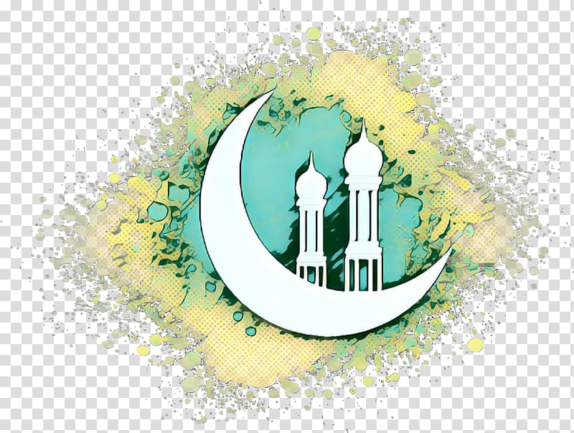
There are 5 main Muslim festivals, they are: Ramadhan, Id-ul-Fit, Eid-ul-adha, Dhu Al-Hijja, and Al Hijra..
FESTIVALS
There are 5 main Muslim festivals, they are: Ramadhan, Id-ul-Fit, Eid-ul-adha, Dhu Al-Hijja, and Al Hijra.
Ramadhan is the ninth month in the Islamic year. In this month, Muslims fast (don’t eat in daylight for 30 days.) during daylight. Muslims believe that the gateway to heaven (Jannah) and the gates of hell, named Jahannam, are shut and unavailable during this time.
The festival of Id-ul-adha takes place one day right after Ramadhan, and it’s where family members come and see each other for three days. It’s where people give one another presents. Like Christmas.

Slide 6
THE FIVE PILLARS
The five pillars of Islam are named, Hajj, Zakah, Shahadah, Salah and Sawm. Each of them have a different meaning.
Hajj: means to travel up to Mecca. It is said the Muslims are only allowed to travel to Mecca once in their life.
Zakah: Giving money towards the poor/ charity. It means that they give some of their hard earned money to people with less money, even if their not Muslim.
Shahadah: Means when one transfers from one religion to Islam, and to enter Islamic faith.
Salah: To pray. Muslims pray five times a day, each having a two hour difference between each one. But, they have to wash themselves fully before praying.
Sawm: To fast. The pillar of Sawm means to fast during the days of Ramadhan.
The Five Pillars of Islam are named,

