Slide 1
horses
Read through this interesting fact file all about horses, breeds behaviour, ridden work and much more

Slide 2
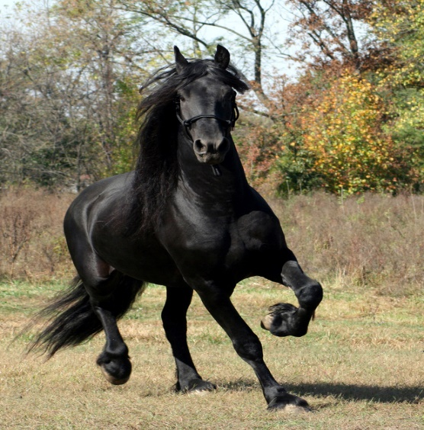
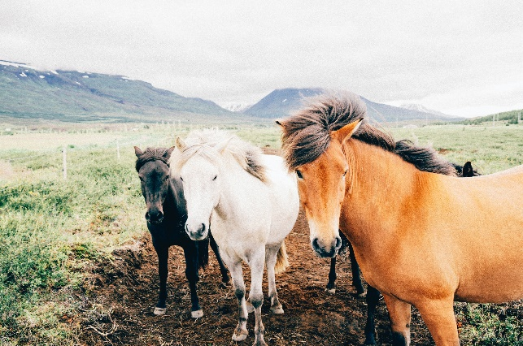
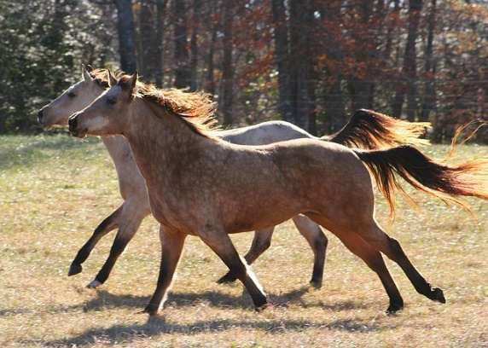
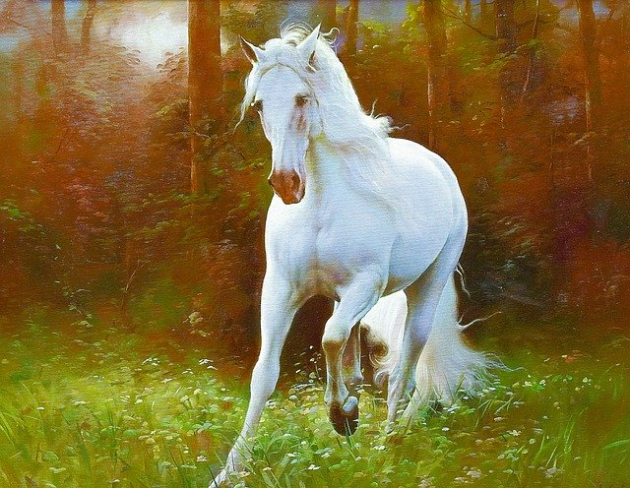
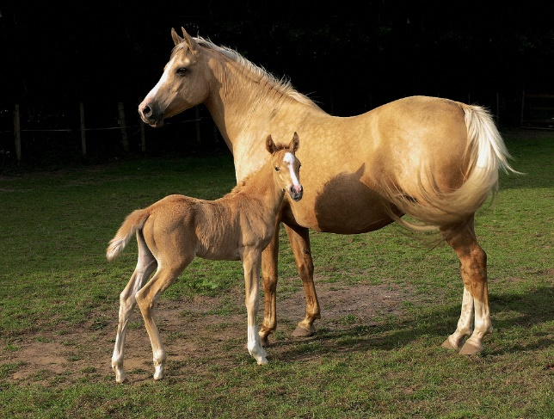
Interesting facts about horses
Horse breeds
Horses history
Wild horses
Male horses
Female horses
Ridden work
End slide
Link of horse vids☺

Slide 3
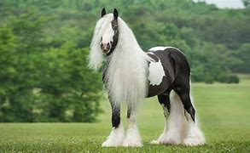
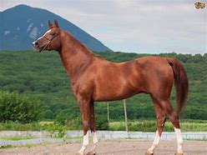
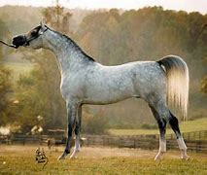
Horse breeds
HOME
There are over 200 horse breeds world wide. These beautiful creatures scatter all over the planet, used for many different things, e.g. barrel racing, show jumping, racing, dressage, mounted games and many more. These loving creatures are incredibly stunning creatures and are powerful enough to pull a car out of mud with one single horse.

Slide 4
HORSES HISTORY
HOME
Horses looked so much more smaller and different to what they are now. They were small and weak with claw like feet like dogs and cats. Our furry freinds have been around for up to, 55million years. They have adapted to their surroundings and grown big and strong like they are now.

Slide 5
WILD HORSES
HOME
Wild horses are scared of humans and roam around the beaches, mores and grassy fields with their herd. They are known to stay in groups called, ‘herds’. If you see a horse in a enclosed field, it is owned by someone and is kept in a field.

Slide 6
Male horses
HOME
Male horses are kind and caring and looks after his rider. They are not grumpy and love company most of the time. They enjoy attention and are very talented when they are fully educated. They are known as stallions when they are not injected and geldings when they are.

Slide 7
FEMALE HORSES
HOME
Female horses have seasons when they are grumpy and don’t do well while riding. When they are not in season they are very intelligent horses. Females are known as mares and they are more inclined to, bite, kick and misbehave.

Slide 8
RIDDEN WORK
HOME
horses have one speciality on ridden work. They can all do everything but may be amazing and one particular activity. Some have a cheeky personality while riding and some may be very concentrated on their work and enjoy doing it. They might be, steady, slow, fast and gentle movement. Most of them enjoy cross country or jumping and even dressage.

Slide 9
LINK OF HORSE VIDEOS☺☺☺
https://www.bing.com/videos/search?q=horses&FORM=VDVVX
Please watch any of these videos about horses ☺
You don’t have to watch them if u don’t want to☺

Slide 10
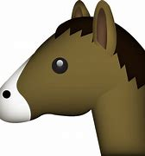
HOME
Thank you for watching !!!

