Slide 1
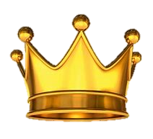
KING ALFRED THE GREAT

Slide 2
King Alfred
Early life
Marriage
Illness
Why he was called King Alfred the GREAT
Family
Last slide

Slide 3
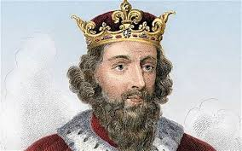
Early life
Back
King Alfred was born in 849 AD in Wantage, Berkshire and died in 899 AD. He was an intelligent child who loved to memorize poems and stories, and he even won a prize for memorizing a whole book!!! His 3 brothers were all king before him but in 871 AD King Alfred earnt his place on the thrown. He reigned for 28 years but he never thought that he was going to become king. In 858 AD, when Alfred was only 9 years old, his dad (Aethelwulf) sadly died.
(If you want to learn more about Alfred’s
brothers, go onto the slide named Alfred’s
Brothers).

Slide 4
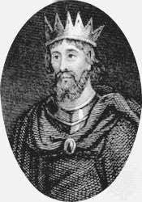
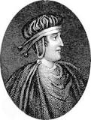
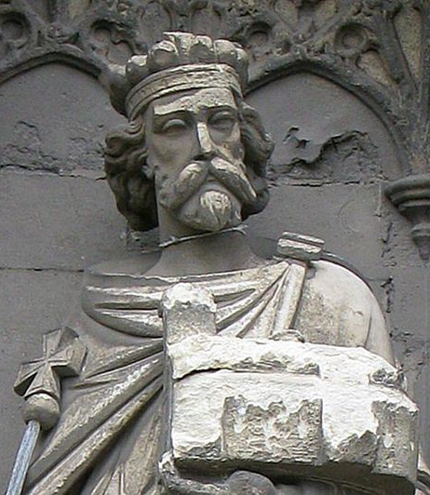
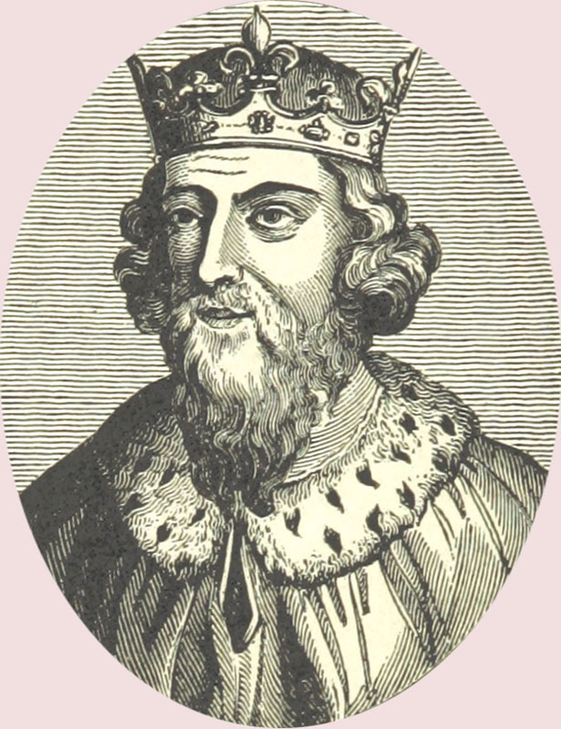
Alfred's Brothers
Alfred had 3 brothers (Æthelred, Æthelbald and Æthelberht) who were all king before him. Æthelred died in 871 AD, Æthelbald died in 860 AD and Æthelberht died in 816 AD.
Æthelberht
Æthelbald
Æthelred
Alfred

Slide 5
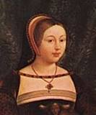
Marriage
Back
In 868 AD, King Alfred got married to Ealhswith or also spelt Ealhswithha. They had 6 children called Ethelflaed, Edward the elder, Ethelweard, Ethelgifu Edmund and elfthryth.

Slide 6
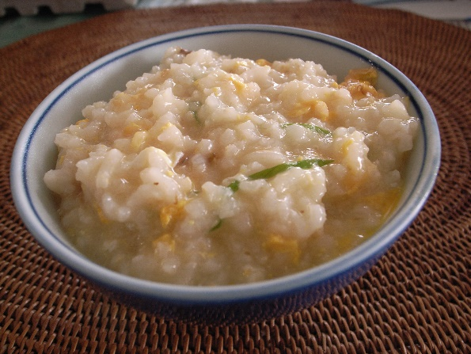
Illness
Back
King Alfred had an illness (Chrohns disease)that he had suffered from most of his life. Because of that, he was not allowed to eat any meat and all he could eat was tasteless gruel, so no one ever wanted to share their food with him.

Slide 7
Why he was CALLED King Alfred the great
Back
Have you ever wondered why King Alfred the Great was so great? Well, Alfred was great because he had translated books from Latin to English so everyone could understand it. He also built walls to keep him safe from the Anglo – Saxons. Did you also know that Alfred was the only English king to be called ‘ the great ‘?
Latin
English

Slide 8
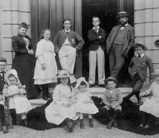
Family
Back
King Alfred had a Very big family. He had 32 family members and even a few more!!!!!!!
3 Sons
3 Daughters
6 Grandsons
1 Grandfather
3 Brothers
1 Wife
2 Nephews
5 Granddaughters
5 Great-grandsons
1 Great – grandfather
2 Great-granddaughters

Slide 9
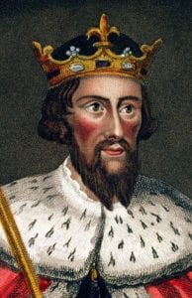
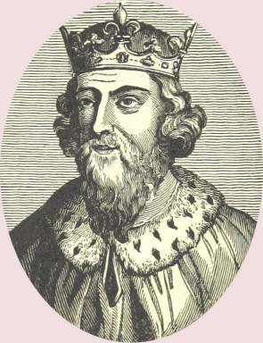
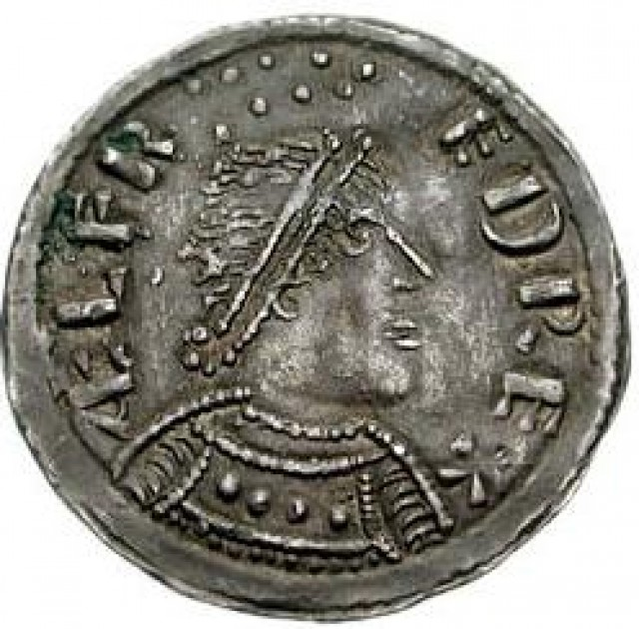
Thanks for watching!!
King Alfred coin

