Slide 1
Vikings
Who are the Vikings???
The Vikings were a fearsome people.
They always raided because they were not afraid of losing the battle.
They were trained to fight.

Slide 2
Vikings weapons
The Vikings used axes, swords and cross bows .
They were effective in battle because
they had cross bows at the back of the battle firing at the enemies. At the front were the sword and axe men.

Slide 3
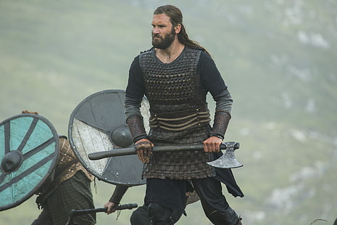
Viking armour
Viking armour wasn’t the strongest but it was light weight and easy to move in so they could run in battle and dodge hits.The armour was made out of chain mail and animal skin over it so the enemies thought they were unprepared.

Slide 4
The Vikings were very bad people but they had there good side. They brought trading to England and united the country. But they killed so many people so which side are you? Do you think the Vikings were good or bad??

Slide 5
Thanks for watching!!!

